Slide 1
PSB of Renaissance
“ The Class !, got a better title ? ”

Slide 2
Students w/ PSB of Renaissance
~ Maitreyee
~ Amrita
~ Anahita
~ Meera
~ Abhinav
~ Animesh

Slide 3
- Maitreyee -
~ Painting - The School of Athens
~ Statue - The Gates of Paradise
~ Building - St. Peter’s Basilica

Slide 4
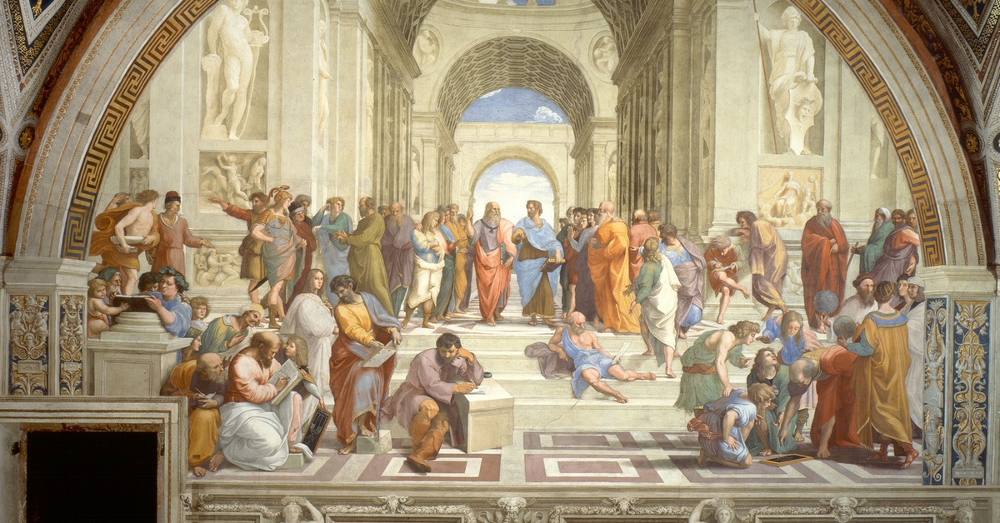
The School of Athens
Painting by Raphael
The School of Athens is a fresco by the Italian Renaissance artist Raphael. It was painted between 1509 and 1511 as a part of Raphael's commission to decorate the rooms now known as the Stanze di Raffaello, in the Apostolic Palace in the Vatican.
*Fresco - a technique of mural painting executed upon freshly laid lime plaster.

Slide 5
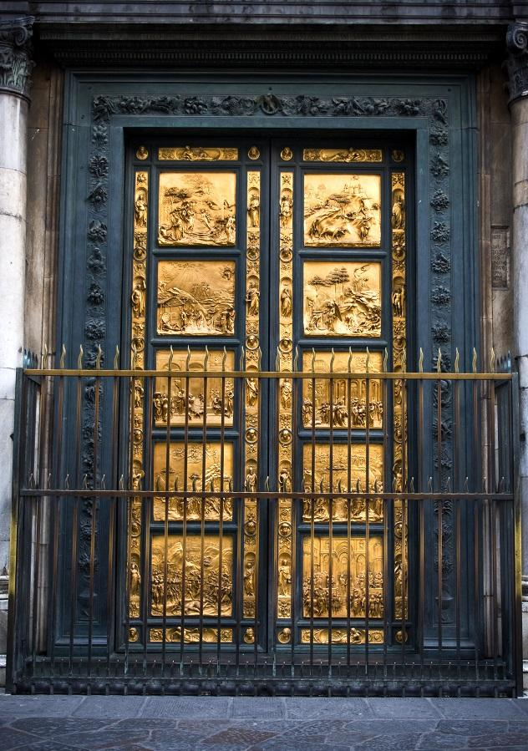
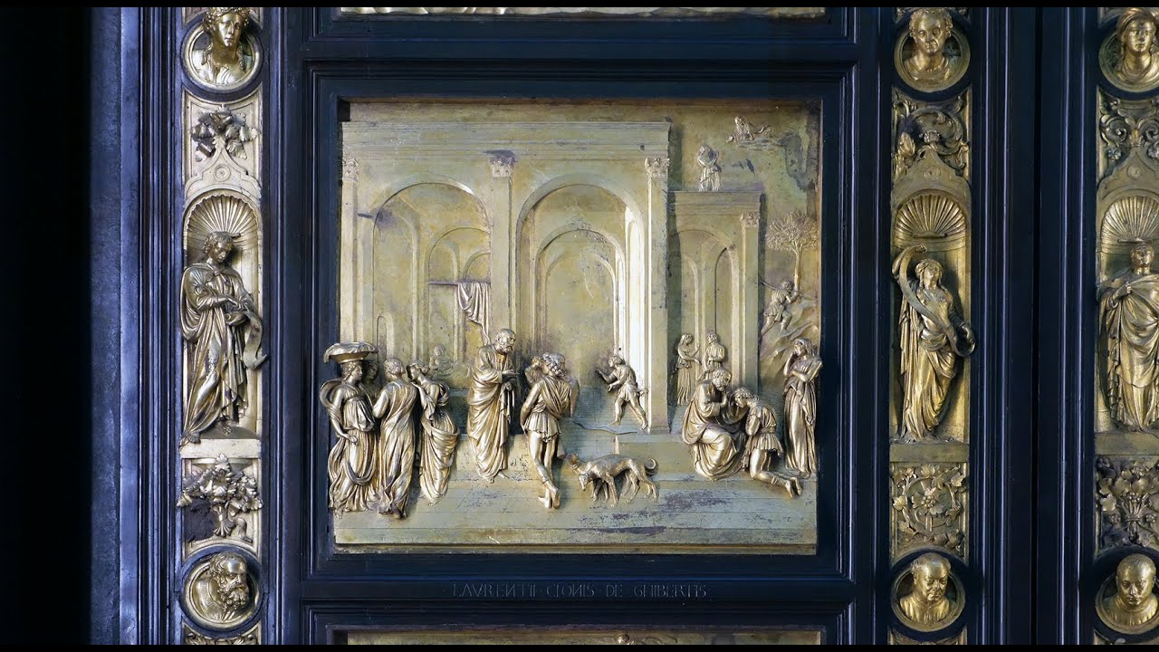
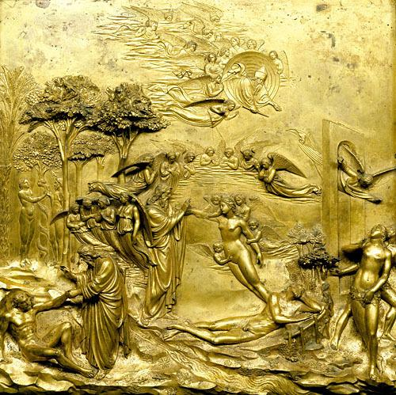
The Gates of Paradise
Sculpture by Lorenzo Ghiberti
Famous golden doors of landmark Baptistery of St. John, with panels depicting Biblical scenes.

Slide 6
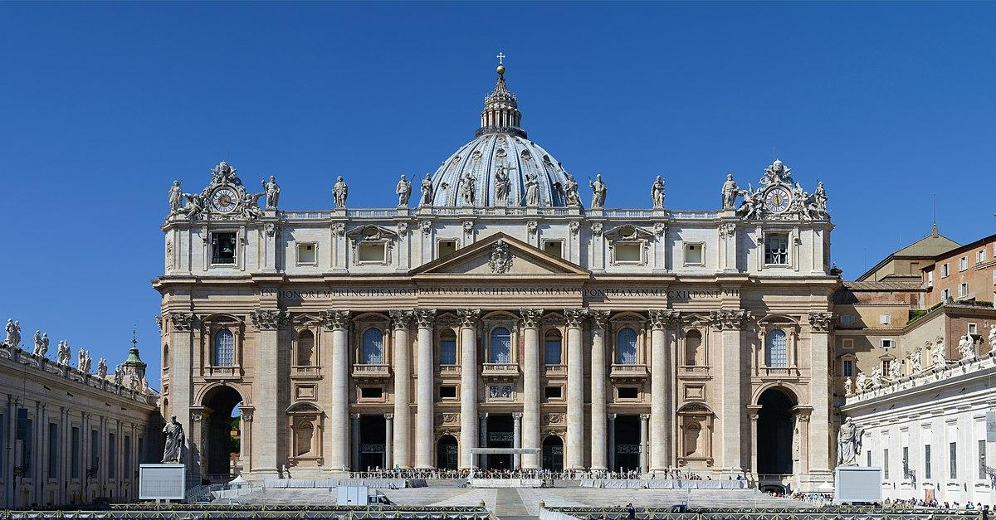
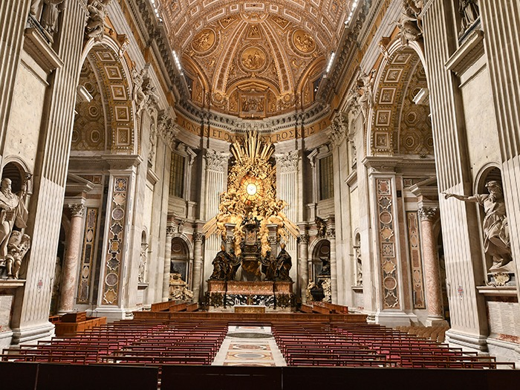
St. Peter’s Basilica
The Papal Basilica of Saint Peter in the Vatican, or simply Saint Peter's Basilica, is a church built in the Renaissance style located in Vatican City, the papal enclave that is within the city of Rome.

Slide 7
- Amrita -
~ Painting - Praying Hands
~ Statue - David
~ Building - Hospital of Innocents

Slide 8
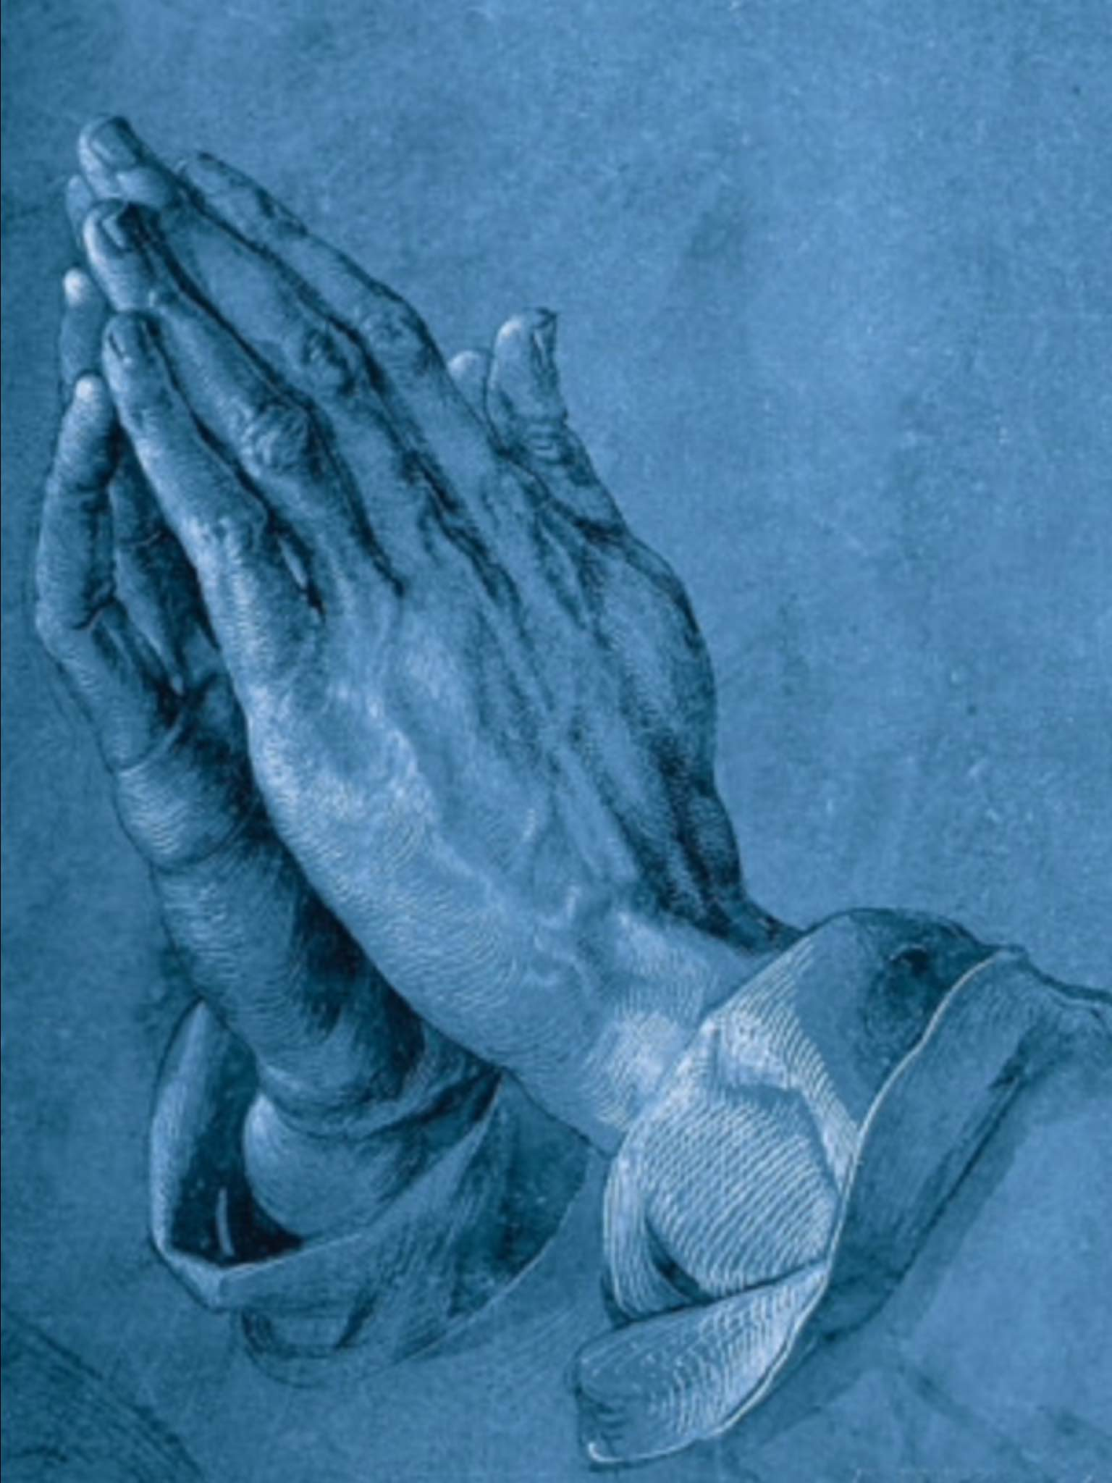
Praying Hands
Painting by Albrecht Dürer
Praying hands, also known as Study of the Hands of an Apostle, is a pen-and-ink drawing by the German printmaker, painter and theorist Albrecht Dürer. The work is today stored at the Albertina museum in Vienna, Austria.

Slide 9
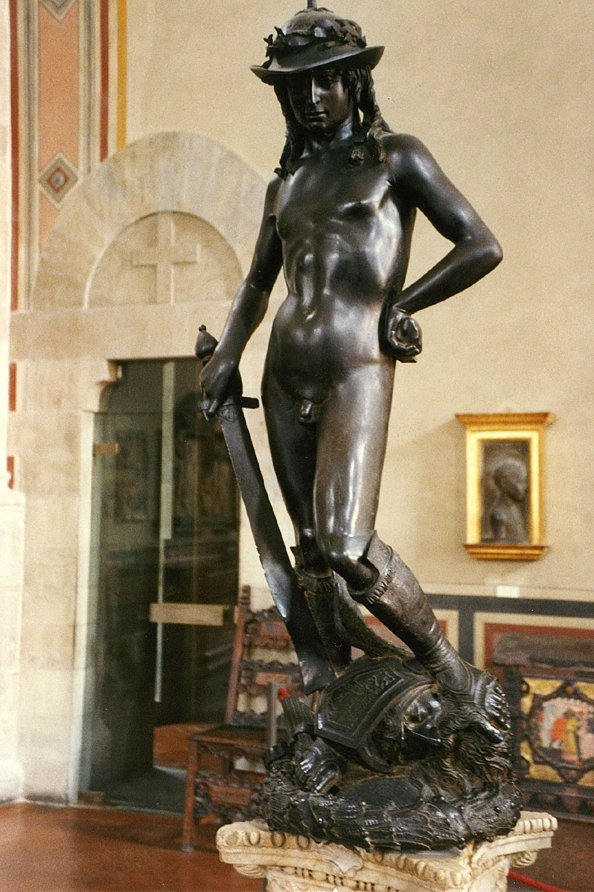
David
Statue by Donatello
David is the title of two statues of the biblical hero David by the Italian early Renaissance sculptor Donatello. They consist of an early work in marble of a clothed figure, and a far more famous bronze figure that is nude except for helmet and boots, and dates to the 1440s or later.

Slide 10
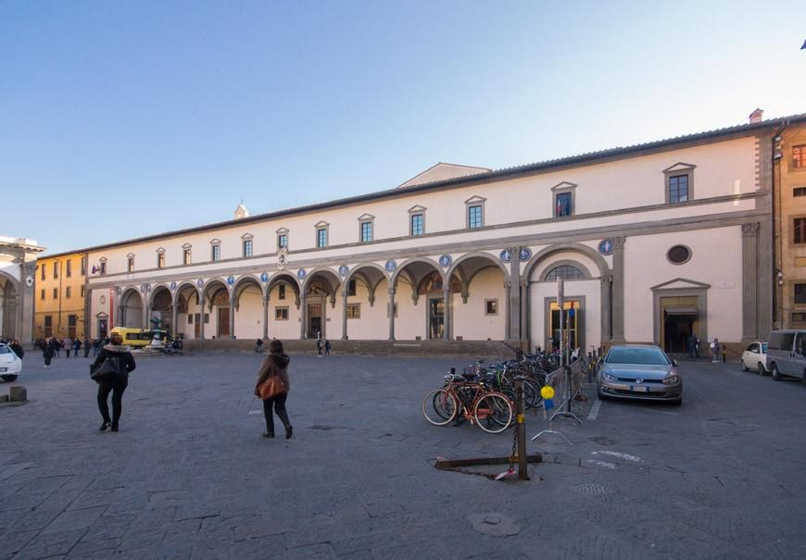
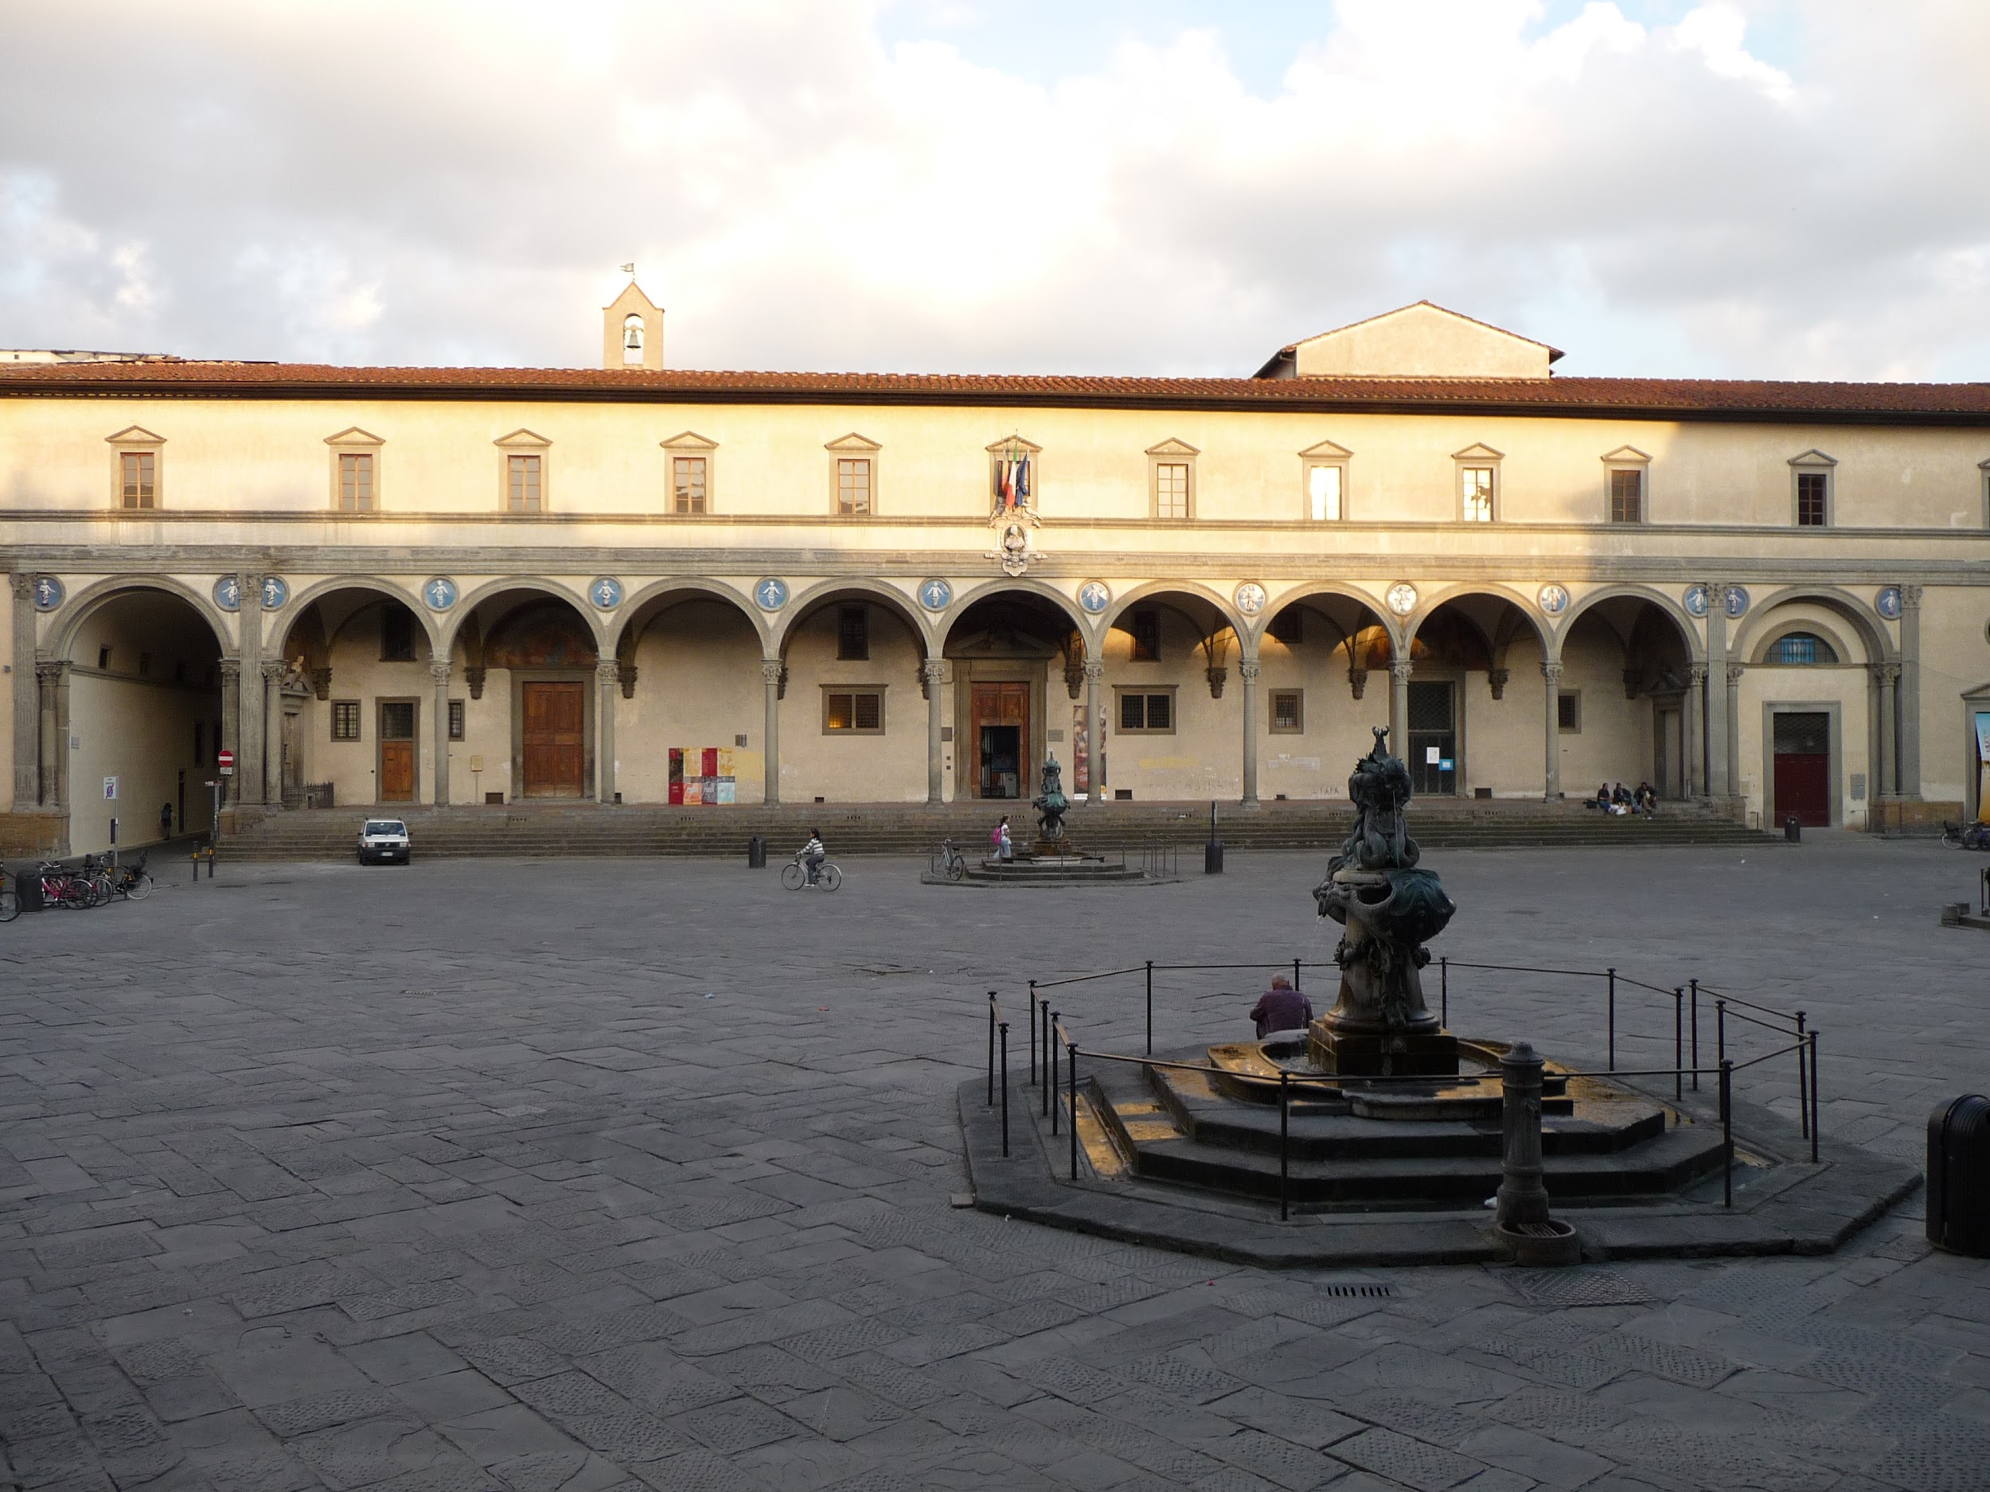
Hospital of Innocents
The Ospedale degli Innocenti is a historic building in Florence, Italy. It was designed by Filippo Brunelleschi, who received the commission in 1419 from the Arte della Seta. It was originally a children's orphanage. It is regarded as a notable example of early Italian Renaissance architecture.

Slide 11
- Anahita -
~ Painting - The Last Supper
~ Statue - La Pieta
~ Building - Piazza Santa Maria Novella

Slide 12
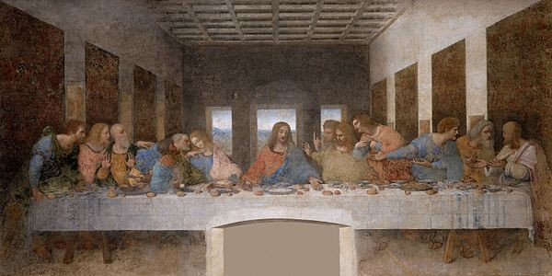
The Last Supper
Painting by Leonardo da Vinci
The Last Supper is a late 15th-century mural painting by Italian artist Leonardo da Vinci housed by the refectory of the Convent of Santa Maria delle Grazie in Milan, Italy. It is one of the Western world's most recognizable paintings.

Slide 13
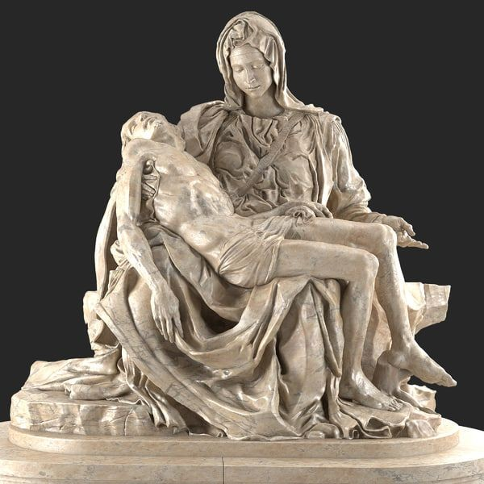
La Pieta
Statue by Michelangelo
The Pietà is a work of Renaissance sculpture by Michelangelo Buonarroti, housed in St. Peter's Basilica, Vatican City.It is the first of a number of works of the same theme by the artist. The statue was commissioned for the French Cardinal Jean de Bilhères, who was a representative in Rome. The sculpture, in Carrara marble, was made for the cardinal's funeral monument, but was moved to its current location, the first chapel on the north side of the entrance of the basilica, in the 18th century. It is the only piece Michelangelo ever signed. It is also the only known sculpture created by a prominent name from the Renaissance era that was installed in St. Peter's Basilica that was accepted by the Chapter of St. Peter.

Slide 14
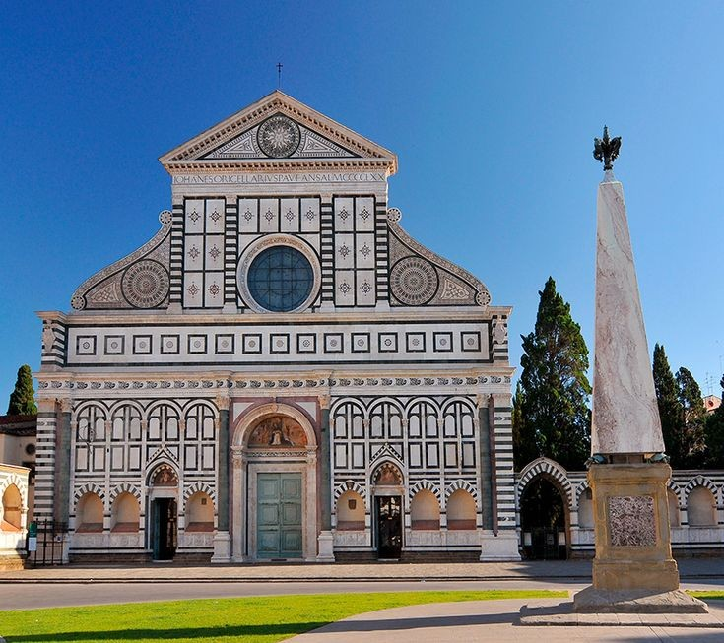
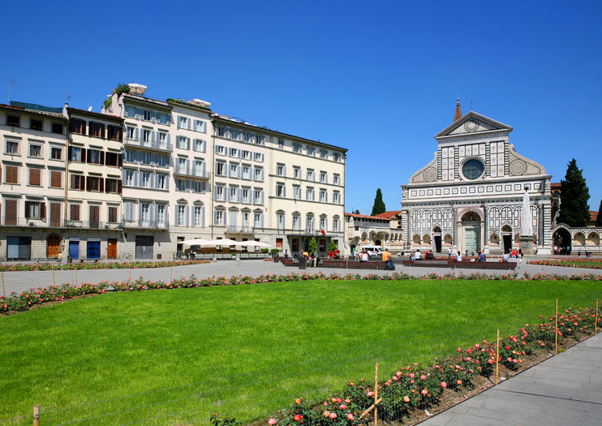
Piazza Santa Maria Novella
Piazza Santa Maria Novella is a city square in Florence, Italy.

Slide 15
- Meera -
~ Painting - The Last Supper
~ Statue - Christ and St. Thomas
~ Building - Château de Chambord

Slide 16
The Last Supper
Painting by Leonardo da Vinci
The Last Supper is a late 15th-century mural painting by Italian artist Leonardo da Vinci housed by the refectory of the Convent of Santa Maria delle Grazie in Milan, Italy. It is one of the Western world's most recognizable paintings.

Slide 17
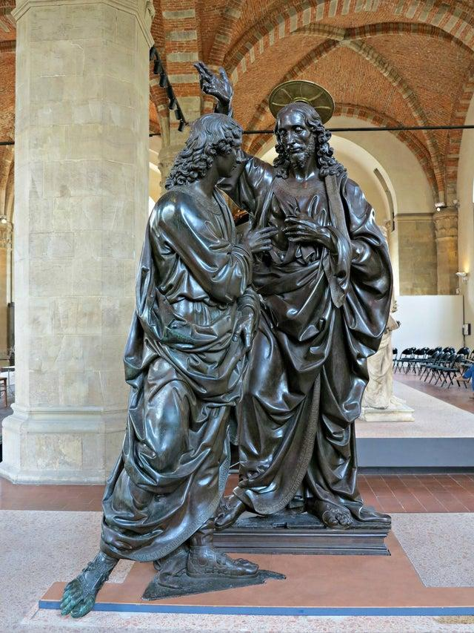
Christ and St. Thomas
Statue by Andrea del Verrocchio
Christ and St. Thomas (1467–1483) is a bronze statue by Andrea del Verrocchio made for one of the 14 niches on the exterior walls of the Orsanmichele in Florence, Italy, where it is now replaced by a cast and the original moved inside the building, which is now a museum. It shows the Incredulity of Thomas, frequently represented in Christian art since at least the 5th century and used to make a variety of theological points. Thomas the Apostle doubted the resurrection of Jesus and had to feel the wounds for himself in order to be convinced John. The surrounding marble niche was designed by Donatello for his St Louis of Toulouse (1413), but the statue was moved to Santa Croce when the niche was sold to the Tribunale di Mercanzia (merchant's guild), who commissioned the Verrochio work.

Slide 18
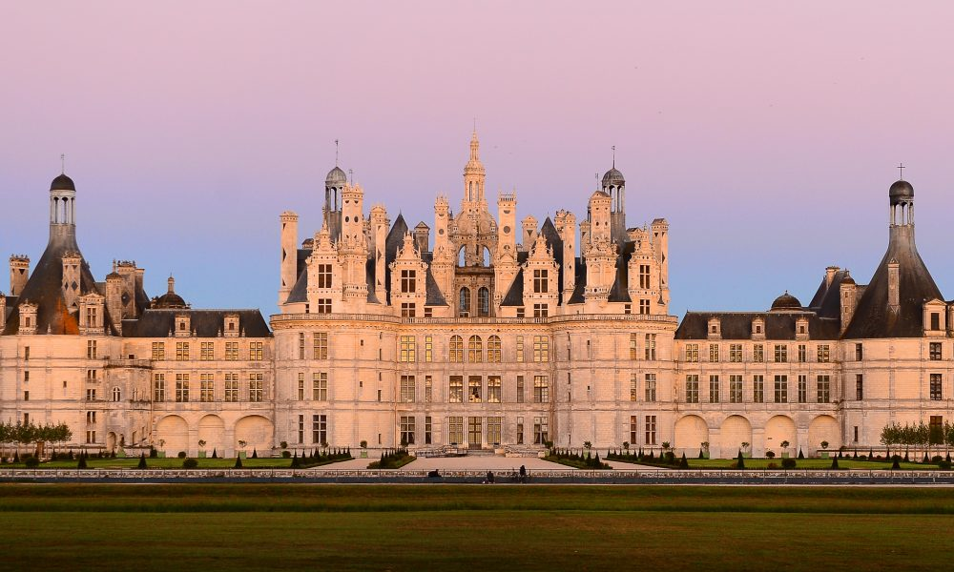
Château de Chambord
The Château de Chambord in Chambord, Centre Region, France, is one of the most recognisable châteaux in the world because of its very distinctive French Renaissance architecture which blends traditional French medieval forms with classical Renaissance structures.

Slide 19
- Abhinav -
~ Painting - The Last Supper
~ Statue - Fonte Gaia
~ Building - Piazza Santa Maria Novella

Slide 20
The Last Supper
Painting by Leonardo da Vinci
The Last Supper is a late 15th-century mural painting by Italian artist Leonardo da Vinci housed by the refectory of the Convent of Santa Maria delle Grazie in Milan, Italy. It is one of the Western world's most recognizable paintings.

Slide 21
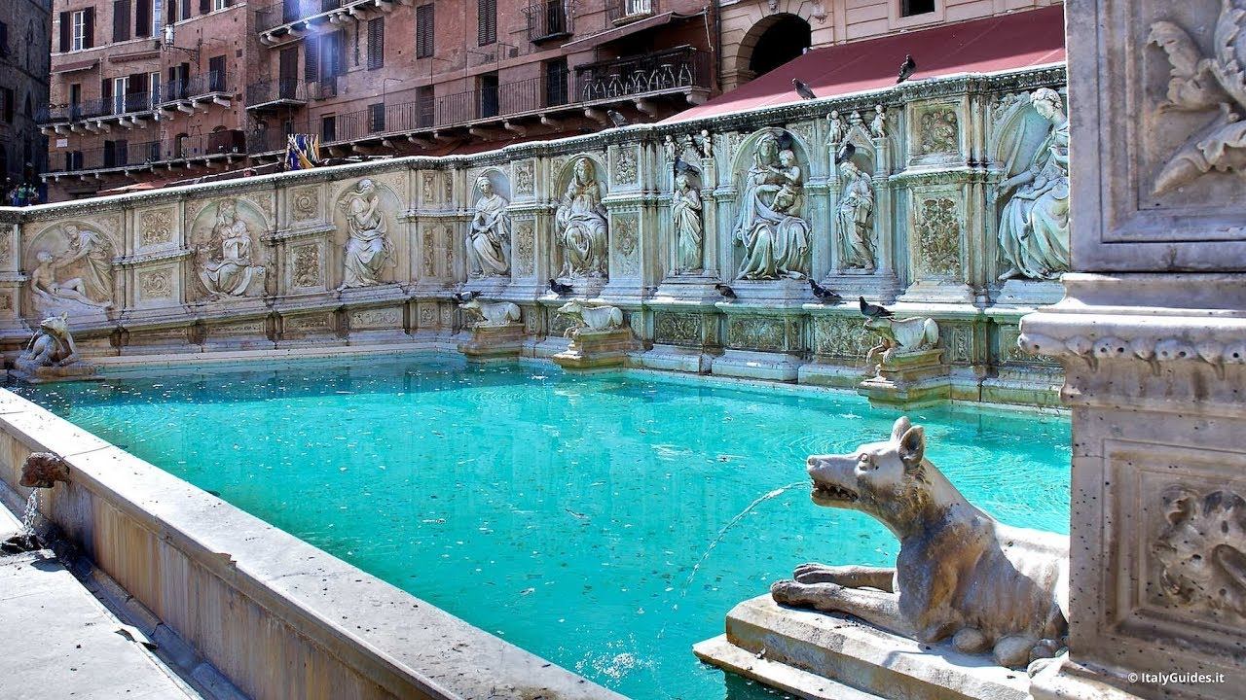
Fonte Gaia
By Various Artists
The Fonte Gaia is a monumental fountain located in the Piazza del Campo in the center of Siena, Italy. The first fountain in the Piazza del Campo was completed in 1342, after hydraulic construction had led water to the site. Underground pipes brought water to the site from 25 kilometers away.

Slide 22
Piazza Santa Maria Novella
Piazza Santa Maria Novella is a city square in Florence, Italy.

Slide 23
- Animesh -
~ Painting - Vitruvian Human
~ Statue - Mosè di Michelangelo ( Moses )
~ Building - Sistine Chapel

Slide 24
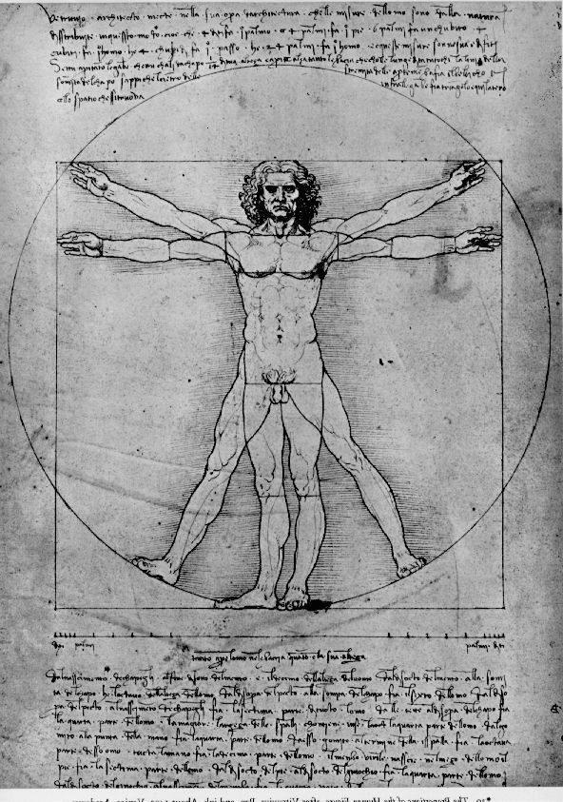
Vitruvian Human
By Leonardo da Vinci
'The proportions of the human body according to Vitruvius') is a drawing made by the Italian polymath Leonardo da Vinci in about 1490.
It is accompanied by notes based on the work of the Roman architect Vitruvius. The drawing, which is in ink on paper, depicts a man in two superimposed positions with his arms and legs apart and inscribed in a circle and square.The drawing represents da Vinci's concept of the ideal human body proportions. Its inscription in a square and a circle comes from a description by the ancient Roman architect Vitruvius in Book III of his treatise De architectura. Yet, as it has been demonstrated, Leonardo did not represent Vitruvius's proportions of the limbs but rather included those he found himself after measuring male models in Milan.[2] While the drawing is named after Vitruvius, some scholars today question the appropriateness of such a title, given that it was first used in the 1940s. First published in reproduction in 1810, the drawing did not attain its present fame until further reproduced in the late 19th century, and it is not clear that it influenced artistic practice in Leonardo's day or later.

Slide 25
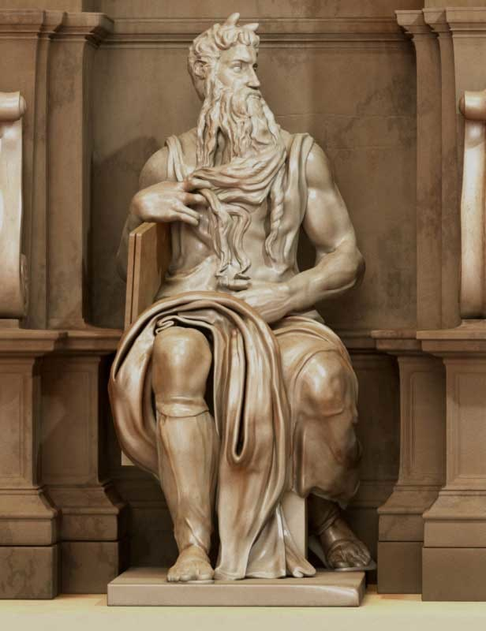
Mosè di Michelangelo ( Moses )
By Michelangelo
Moses is a sculpture by the Italian High Renaissance artist Michelangelo Buonarroti, housed in the church of San Pietro in Vincoli in Rome. Commissioned in 1505 by Pope Julius II for his tomb, it depicts the biblical figure Moses with horns on his head, based on a description in chapter 34 of Exodus in the Vulgate, the Latin translation of the Bible used at that time.

Slide 26
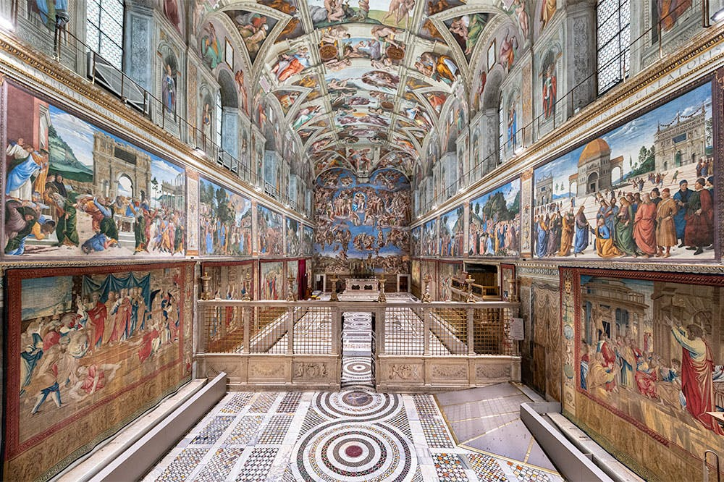
Sistine Chapel
The Sistine Chapel is a chapel in the Apostolic Palace, the official residence of the pope, in Vatican City. Originally known as the Cappella Magna ('Great Chapel'), the chapel takes its name from Pope Sixtus IV, who restored it between 1473 and 1481. Since that time, the chapel has served as a place of both religious and functionary papal activity. Today, it is the site of the papal conclave, the process by which a new pope is selected. The fame of the Sistine Chapel lies mainly in the frescos that decorate the interior, most particularly the Sistine Chapel ceiling and The Last Judgment, both by Michelangelo.

